Slide 1
Welcome

Slide 2
Testing

Slide 3
Testing
Make sure that features you’ve implemented work as intended

Slide 4
Benefit Testing

Slide 5
Benefit of Testing
Rapid feedback on failures

Slide 6
Benefit of Testing
Rapid feedback on failures
Early failure detection

Slide 7
Benefit of Testing
Rapid feedback on failures
Early failure detection
Safer code refactoring

Slide 8
Benefit of Testing
Rapid feedback on failures
Early failure detection
Safer code refactoring
Stable development env.

Slide 9
Test Driven Development

Slide 10
TDD

Slide 11
Testing Pyramid
Notes:
Small tests are unit tests that validate your app's behavior one class at a time.
Medium tests are integration tests that validate either interactions between levels of the stack within a module, or interactions between related modules.
Large tests are end-to-end tests that validate user journeys spanning multiple modules of your app.

Slide 12
Testing Pyramid
Large tests
Medium tests
Small tests
Notes:
Small tests are unit tests that validate your app's behavior one class at a time.
Medium tests are integration tests that validate either interactions between levels of the stack within a module, or interactions between related modules.
Large tests are end-to-end tests that validate user journeys spanning multiple modules of your app.

Slide 13
Testing Pyramid
Large tests
10%
Medium tests
20%
Small tests
70%
Notes:
Small tests are unit tests that validate your app's behavior once class at a time. “Validate the functionality”.
Medium tests are integration tests that validate either interactions between levels of the stack within a module, or interactions between related modules.
Large tests are end-to-end tests that validate user journeys spanning multiple modules of your app.

Slide 14
How can I know the level?
Notes:
Small tests are unit tests that validate your app's behavior once class at a time. “Validate the functionality”.
Medium tests are integration tests that validate either interactions between levels of the stack within a module, or interactions between related modules.
Large tests are end-to-end tests that validate user journeys spanning multiple modules of your app.

Slide 15
Small
Notes:
Small tests are unit tests that validate your app's behavior once class at a time. “Validate the functionality”.
Medium tests are integration tests that validate either interactions between levels of the stack within a module, or interactions between related modules.
Large tests are end-to-end tests that validate user journeys spanning multiple modules of your app.

Slide 16
Small
Class at a time
Notes:
Small tests are unit tests that validate your app's behavior once class at a time. “Validate the functionality”.
Medium tests are integration tests that validate either interactions between levels of the stack within a module, or interactions between related modules.
Large tests are end-to-end tests that validate user journeys spanning multiple modules of your app.

Slide 17
Small
Class at a time
Validate the functionality
Notes:
Small tests are unit tests that validate your app's behavior once class at a time. “Validate the functionality”.
Medium tests are integration tests that validate either interactions between levels of the stack within a module, or interactions between related modules.
Large tests are end-to-end tests that validate user journeys spanning multiple modules of your app.

Slide 18
Small
Medium
Class at a time
Validate the functionality
Notes:
Small tests are unit tests that validate your app's behavior once class at a time. “Validate the functionality”.
Medium tests are integration tests that validate either interactions between levels of the stack within a module, or interactions between related modules.
Large tests are end-to-end tests that validate user journeys spanning multiple modules of your app.

Slide 19
Small
Medium
Validating XML layout
Class at a time
Validate the functionality
Notes:
Small tests are unit tests that validate your app's behavior once class at a time. “Validate the functionality”.
Medium tests are integration tests that validate either interactions between levels of the stack within a module, or interactions between related modules.
Large tests are end-to-end tests that validate user journeys spanning multiple modules of your app.

Slide 20
Small
Medium
Validating XML layout
Testing Fragment Object
Class at a time
Validate the functionality
Notes:
Small tests are unit tests that validate your app's behavior once class at a time. “Validate the functionality”.
Medium tests are integration tests that validate either interactions between levels of the stack within a module, or interactions between related modules.
Large tests are end-to-end tests that validate user journeys spanning multiple modules of your app.

Slide 21
Small
Medium
Validating XML layout
Testing Fragment Object
Testing interaction between data sources and DAOs
Class at a time
Validate the functionality
Notes:
Small tests are unit tests that validate your app's behavior once class at a time. “Validate the functionality”.
Medium tests are integration tests that validate either interactions between levels of the stack within a module, or interactions between related modules.
Large tests are end-to-end tests that validate user journeys spanning multiple modules of your app.

Slide 22
Small
Medium
Large
Validating XML layout
Testing Fragment Object
Testing interaction between data sources and DAOs
Class at a time
Validate the functionality
Notes:
Small tests are unit tests that validate your app's behavior once class at a time. “Validate the functionality”.
Medium tests are integration tests that validate either interactions between levels of the stack within a module, or interactions between related modules.
Large tests are end-to-end tests that validate user journeys spanning multiple modules of your app.

Slide 23
Small
Medium
Large
Validating XML layout
Testing Fragment Object
Testing interaction between data sources and DAOs
Class at a time
Validate the functionality
End-to-end workflows
Notes:
Small tests are unit tests that validate your app's behavior once class at a time. “Validate the functionality”.
Medium tests are integration tests that validate either interactions between levels of the stack within a module, or interactions between related modules.
Large tests are end-to-end tests that validate user journeys spanning multiple modules of your app.

Slide 24
Small test
Notes:
Small tests are unit tests that validate your app's behavior once class at a time. “Validate the functionality”.
Medium tests are integration tests that validate either interactions between levels of the stack within a module, or interactions between related modules.
Large tests are end-to-end tests that validate user journeys spanning multiple modules of your app.

Slide 25
Small test
If your tests rely on resources, enable the
includeAndroidResources option in app gradle
Notes:
Small tests are unit tests that validate your app's behavior once class at a time. “Validate the functionality”.
Medium tests are integration tests that validate either interactions between levels of the stack within a module, or interactions between related modules.
Large tests are end-to-end tests that validate user journeys spanning multiple modules of your app.

Slide 26
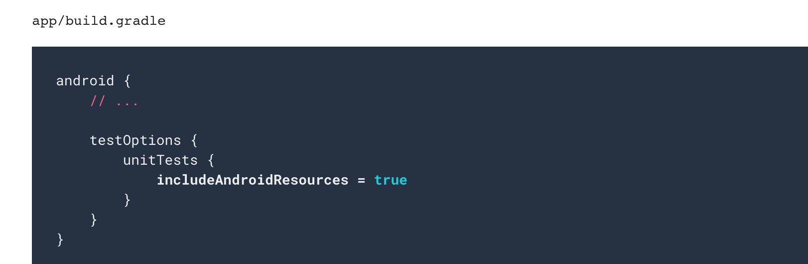
Small test
Notes:
Small tests are unit tests that validate your app's behavior once class at a time. “Validate the functionality”.
Medium tests are integration tests that validate either interactions between levels of the stack within a module, or interactions between related modules.
Large tests are end-to-end tests that validate user journeys spanning multiple modules of your app.

Slide 27
Small test
Notes:
Small tests are unit tests that validate your app's behavior once class at a time. “Validate the functionality”.
Medium tests are integration tests that validate either interactions between levels of the stack within a module, or interactions between related modules.
Large tests are end-to-end tests that validate user journeys spanning multiple modules of your app.

Slide 28
Large Test

Slide 29
Large Test = UI Test

Slide 30
UI Test

Slide 31
UI Test
Single app

Slide 32
UI Test
Single app
Multiple app

Slide 33
Testing Frameworks

Slide 34
UI Test
Single app
Multiple app
Espresso

Slide 35
UI Test
Single app
Multiple app
Espresso
UI Automator

Slide 36
Pre-requisites

Slide 37
Pre-requisites
Add dependencies
Turn animations off

Slide 38
Testing Steps

Slide 39
Testing Steps
Find the view

Slide 40
Testing Steps
Find the view
Perform action

Slide 41
Testing Steps
Find the view
Perform action
Check

Slide 42
Testing Steps
Find the view
Perform action
Check
Find a button

Slide 43
Testing Steps
Find the view
Perform action
Check
Find a button
Click the button

Slide 44
Testing Steps
Find the view
Perform action
Check
Find a button
Click the button
Behave as expected?

Slide 45
Espresso UI Testing

Slide 46
Views

Slide 47
Views
AdapterViews

Slide 48
Views
AdapterViews
Intents

Slide 49
Views
AdapterViews
Intents
Idling resources

Slide 50
Views

Slide 51
Views
Find the view
Notes:
A class that helps us to specify the view that we are interested in in the current view hierarchy
Hamcrest matcher lib = help us to do what we want using a human readable language such as withId()

Slide 52
Views
Find the view
onView()
Notes:
A class that helps us to specify the view that we are interested in in the current view hierarchy
Hamcrest matcher lib = help us to do what we want using a human readable language such as withId()

Slide 53
Views
Find the view
onView(withId())
Notes:
A class that helps us to specify the view that we are interested in in the current view hierarchy
Hamcrest matcher lib = help us to do what we want using a human readable language such as withId()

Slide 54
Views
Find the view
onView(withId(R.id.my_button_id))
Notes:
A class that helps us to specify the view that we are interested in in the current view hierarchy
Hamcrest matcher lib = help us to do what we want using a human readable language such as withId()

Slide 55
Views
Find the view
onView(withId(R.id.my_button_id))
Perform action
Notes:
A class that helps us to specify the view that we are interested in in the current view hierarchy
Hamcrest matcher lib = help us to do what we want using a human readable language such as withId()

Slide 56
Views
Find the view
onView(withId(R.id.my_button_id))
Perform action
perform()
Notes:
A class that helps us to specify the view that we are interested in in the current view hierarchy
Hamcrest matcher lib = help us to do what we want using a human readable language such as withId()

Slide 57
Views
Find the view
onView(withId(R.id.my_button_id))
Perform action
perform(click())
Notes:
A class that helps us to specify the view that we are interested in in the current view hierarchy
Hamcrest matcher lib = help us to do what we want using a human readable language such as withId()

Slide 58
Views
Find the view
onView(withId(R.id.my_button_id))
Perform action
perform(click())
Notes:
A class that helps us to specify the view that we are interested in in the current view hierarchy
Hamcrest matcher lib = help us to do what we want using a human readable language such as withId()

Slide 59
Views
Check
onView(withId(R.id.my_textview))
Notes:
A class that helps us to specify the view that we are interested in in the current view hierarchy
Hamcrest matcher lib = help us to do what we want using a human readable language such as withId()

Slide 60
Views
Check
onView(withId(R.id.my_textview))
.check()
Notes:
A class that helps us to specify the view that we are interested in in the current view hierarchy
Hamcrest matcher lib = help us to do what we want using a human readable language such as withId()

Slide 61
Views
Check
onView(withId(R.id.my_textview))
.check(isDisplayed())
Notes:
A class that helps us to specify the view that we are interested in in the current view hierarchy
Hamcrest matcher lib = help us to do what we want using a human readable language such as withId()

Slide 62
Views
Understand more
Notes:
A class that helps us to specify the view that we are interested in in the current view hierarchy
Hamcrest matcher lib = help us to do what we want using a human readable language such as withId()

Slide 63
Views
onView( ViewMatcher )
Notes:
A class that helps us to specify the view that we are interested in in the current view hierarchy
Hamcrest matcher lib = help us to do what we want using a human readable language such as withId()

Slide 64
Views
onView( ViewMatcher )
perform( ViewAction )
Notes:
A class that helps us to specify the view that we are interested in in the current view hierarchy
Hamcrest matcher lib = help us to do what we want using a human readable language such as withId()

Slide 65
Views
onView( ViewMatcher )
perform( ViewAction )
check( ViewAssertion )
Notes:
A class that helps us to specify the view that we are interested in in the current view hierarchy
Hamcrest matcher lib = help us to do what we want using a human readable language such as withId()

Slide 66
Espresso Cheat Sheet

Slide 68
AdapterViews

Slide 69
AdapterViews
Notes:
Since AdapterViews such as ListView and GridView load data dynamically from an Adapter, only a subset of the contents may be loaded in the current view hierarchy at a time
To handle this we need to use onData() which loads the adapter item we are interested in onto the screen before operating on it.

Slide 70
AdapterViews vs Views
Notes:
DataOptions example of at position, onChildView, inAdapterView
And we will see examples together later.

Slide 71
AdapterViews vs Views

Slide 72
Intents

Slide 73
Stub
Verification

Slide 74
Stub
Verification
Intending()
Intended()

Slide 77
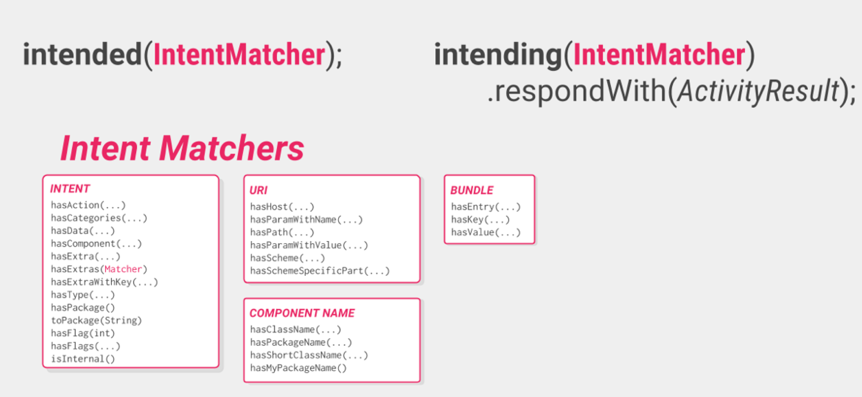

Slide 78
@Before
@After

Slide 79
@Before
@After
Intents.init()
Intents.release()

Slide 80
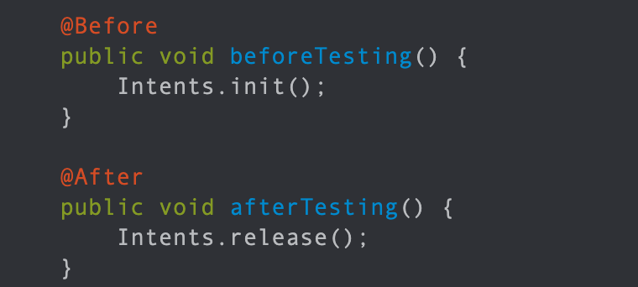

Slide 81
Idling resources

Slide 82
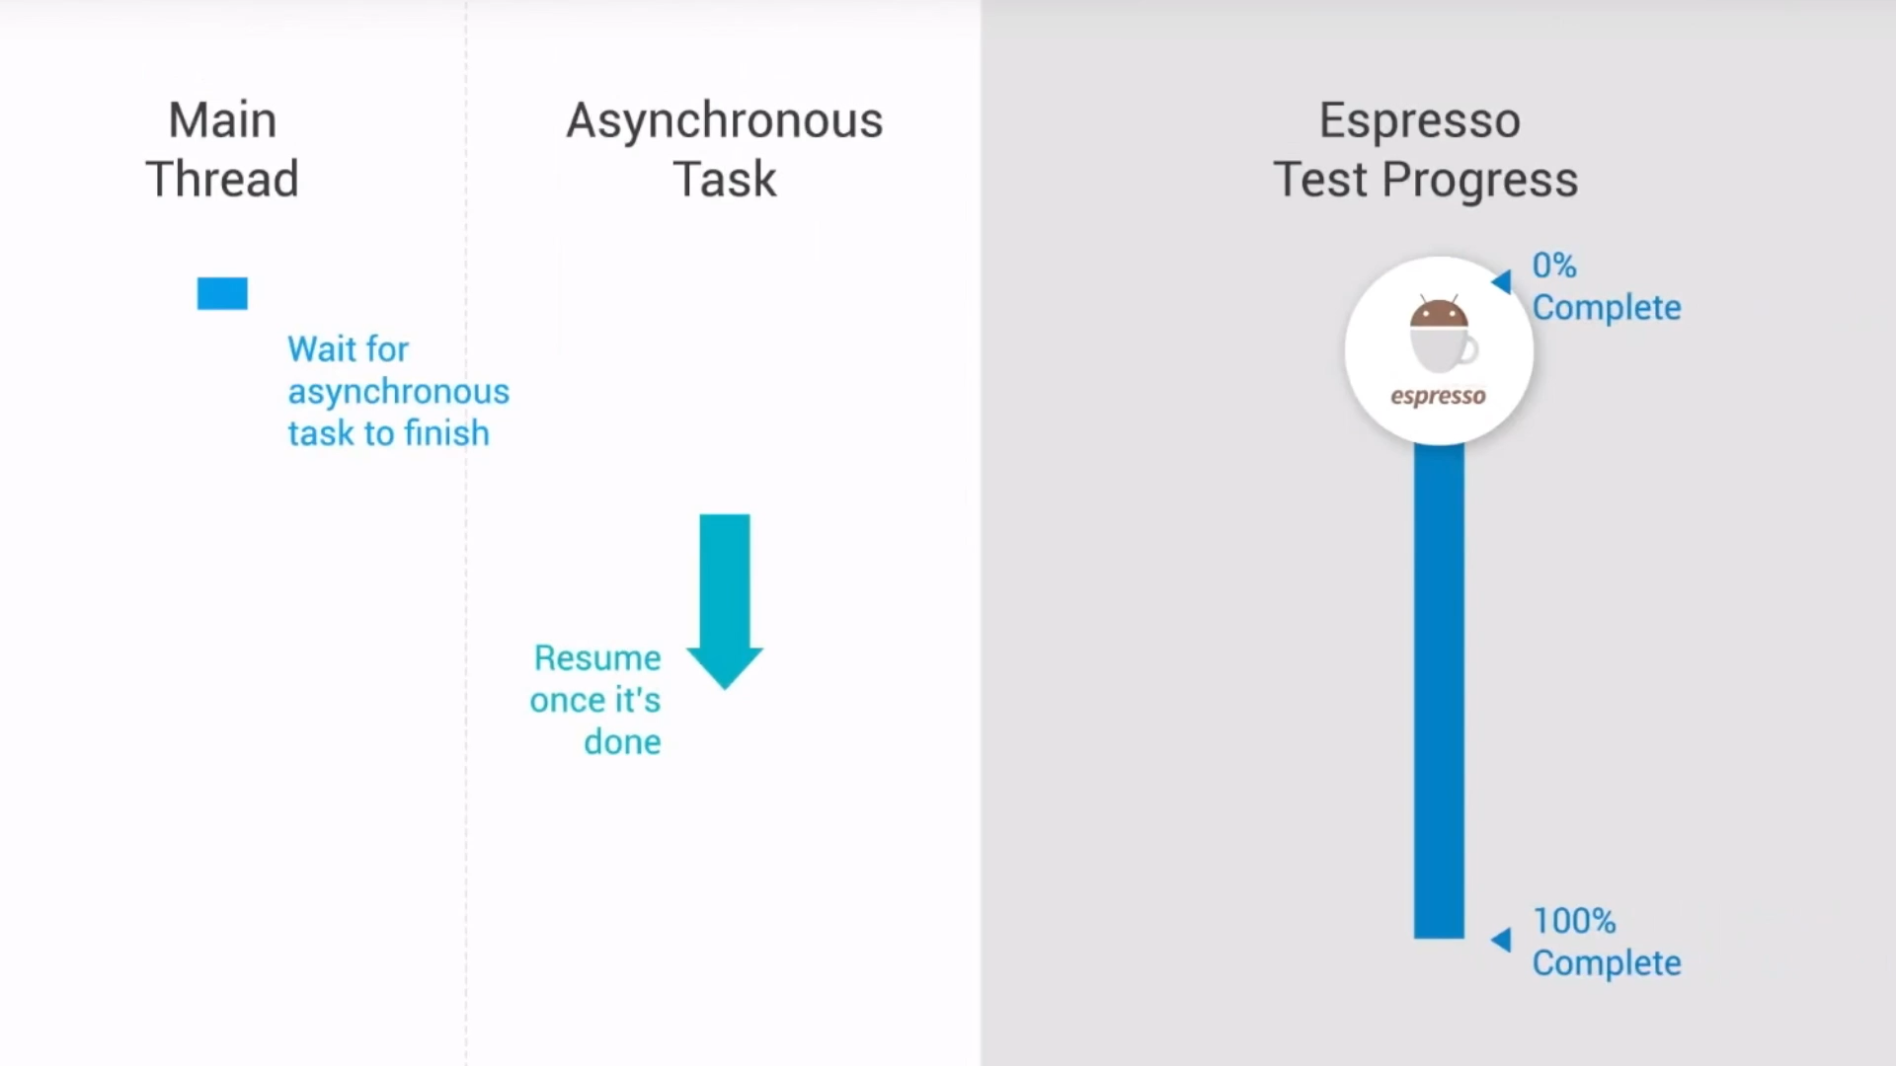

Slide 83
@Before
@Rule
Notes:
@Before
@Rule = if there is something will be used for so many test cases, it’d better to be annotated as Rule.

Slide 84
Recycler View Helper Methods

Slide 85
scrollTo()
Notes:
scrollTo() - Scrolls to the matched View, if it exists.
scrollToHolder() - Scrolls to the matched View Holder, if it exists.
scrollToPosition() - Scrolls to a specific position.
actionOnHolderItem() - Performs a View Action on a matched View Holder.
actionOnItem() - Performs a View Action on a matched View.
actionOnItemAtPosition() - Performs a ViewAction on a view at a specific position.

Slide 86
scrollTo()
scrollToHolder()
Notes:
scrollTo() - Scrolls to the matched View, if it exists.
scrollToHolder() - Scrolls to the matched View Holder, if it exists.
scrollToPosition() - Scrolls to a specific position.
actionOnHolderItem() - Performs a View Action on a matched View Holder.
actionOnItem() - Performs a View Action on a matched View.
c- Performs a ViewAction on a view at a specific position.

Slide 87
scrollTo()
scrollToHolder()
scrollToPosition()
Notes:
scrollTo() - Scrolls to the matched View, if it exists.
scrollToHolder() - Scrolls to the matched View Holder, if it exists.
scrollToPosition() - Scrolls to a specific position.
actionOnHolderItem() - Performs a View Action on a matched View Holder.
actionOnItem() - Performs a View Action on a matched View.
c- Performs a ViewAction on a view at a specific position.

Slide 88
scrollTo()
scrollToHolder()
scrolToPosition()
actionOnHolderItem()
Notes:
scrollTo() - Scrolls to the matched View, if it exists.
scrollToHolder() - Scrolls to the matched View Holder, if it exists.
scrollToPosition() - Scrolls to a specific position.
actionOnHolderItem() - Performs a View Action on a matched View Holder.
actionOnItem() - Performs a View Action on a matched View.
c- Performs a ViewAction on a view at a specific position.

Slide 89
scrollTo()
scrollToHolder()
scrolToPosition()
actionOnHolderItem()
actionOnItem()
Notes:
scrollTo() - Scrolls to the matched View, if it exists.
scrollToHolder() - Scrolls to the matched View Holder, if it exists.
scrollToPosition() - Scrolls to a specific position.
actionOnHolderItem() - Performs a View Action on a matched View Holder.
actionOnItem() - Performs a View Action on a matched View.
actionOnItemAtPosition() - Performs a ViewAction on a view at a specific position.

Slide 90
scrollTo()
scrollToHolder()
scrolToPosition()
actionOnHolderItem()
actionOnItem()
actionOnItemAtPosition()
Notes:
scrollTo() - Scrolls to the matched View, if it exists.
scrollToHolder() - Scrolls to the matched View Holder, if it exists.
scrollToPosition() - Scrolls to a specific position.
actionOnHolderItem() - Performs a View Action on a matched View Holder.
actionOnItem() - Performs a View Action on a matched View.
actionOnItemAtPosition() - Performs a ViewAction on a view at a specific position.

Slide 91
scrollTo()
scrollToHolder()
scrolToPosition()
actionOnHolderItem()
actionOnItem()
actionOnItemAtPosition()
Recycler View Helper Methods
Notes:
scrollTo() - Scrolls to the matched View, if it exists.
scrollToHolder() - Scrolls to the matched View Holder, if it exists.
scrollToPosition() - Scrolls to a specific position.
actionOnHolderItem() - Performs a View Action on a matched View Holder.
actionOnItem() - Performs a View Action on a matched View.
actionOnItemAtPosition() - Performs a ViewAction on a view at a specific position.

Slide 92
Complicated test scenario

Slide 93
./gradlew lint
Notes:
Provide you with a full details of your project and code

Slide 94
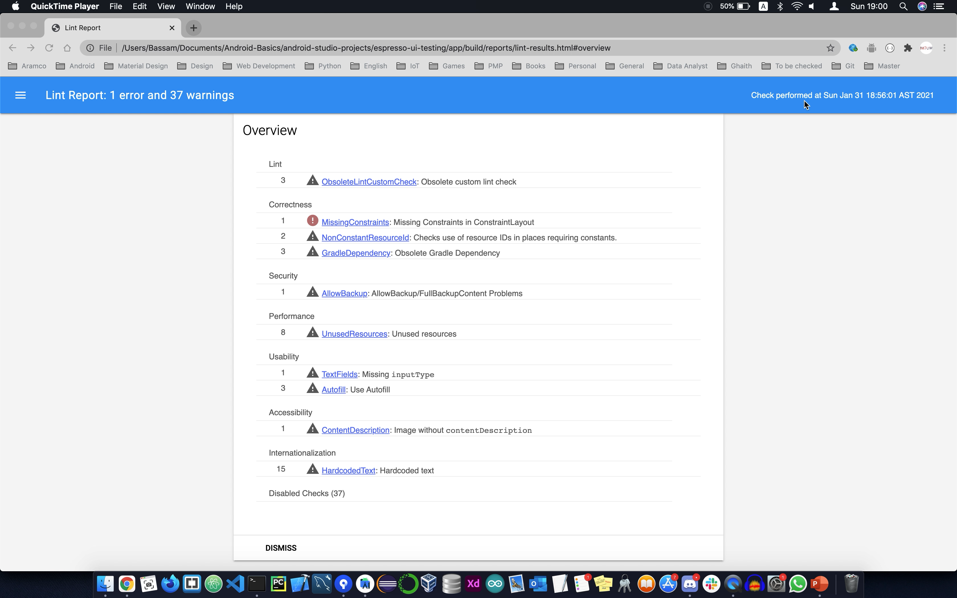

Slide 95
./gradlew connectedCheck
Notes:
Will do a full test for all your test scenarios and provide you with a detailed report.

Slide 96
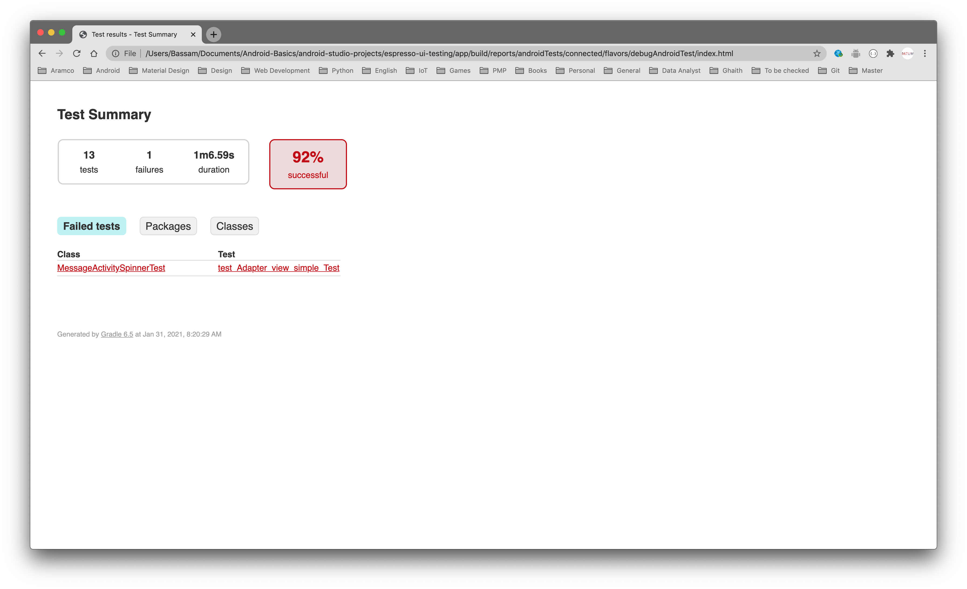
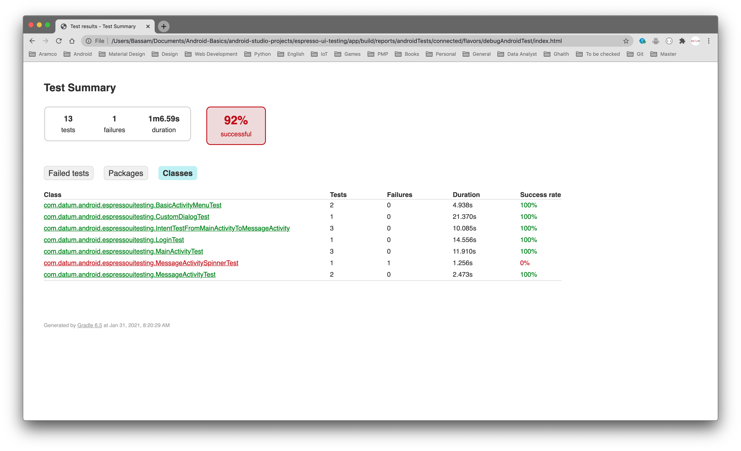
Notes:
Will do a full test for all your test scenarios and provide you with a detailed report.

Slide 97
Firebase lab testing

Slide 98
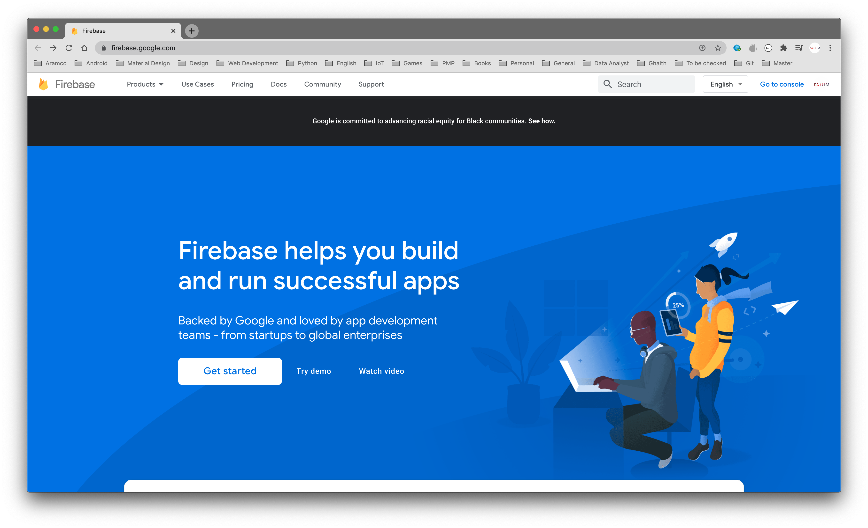

Slide 99
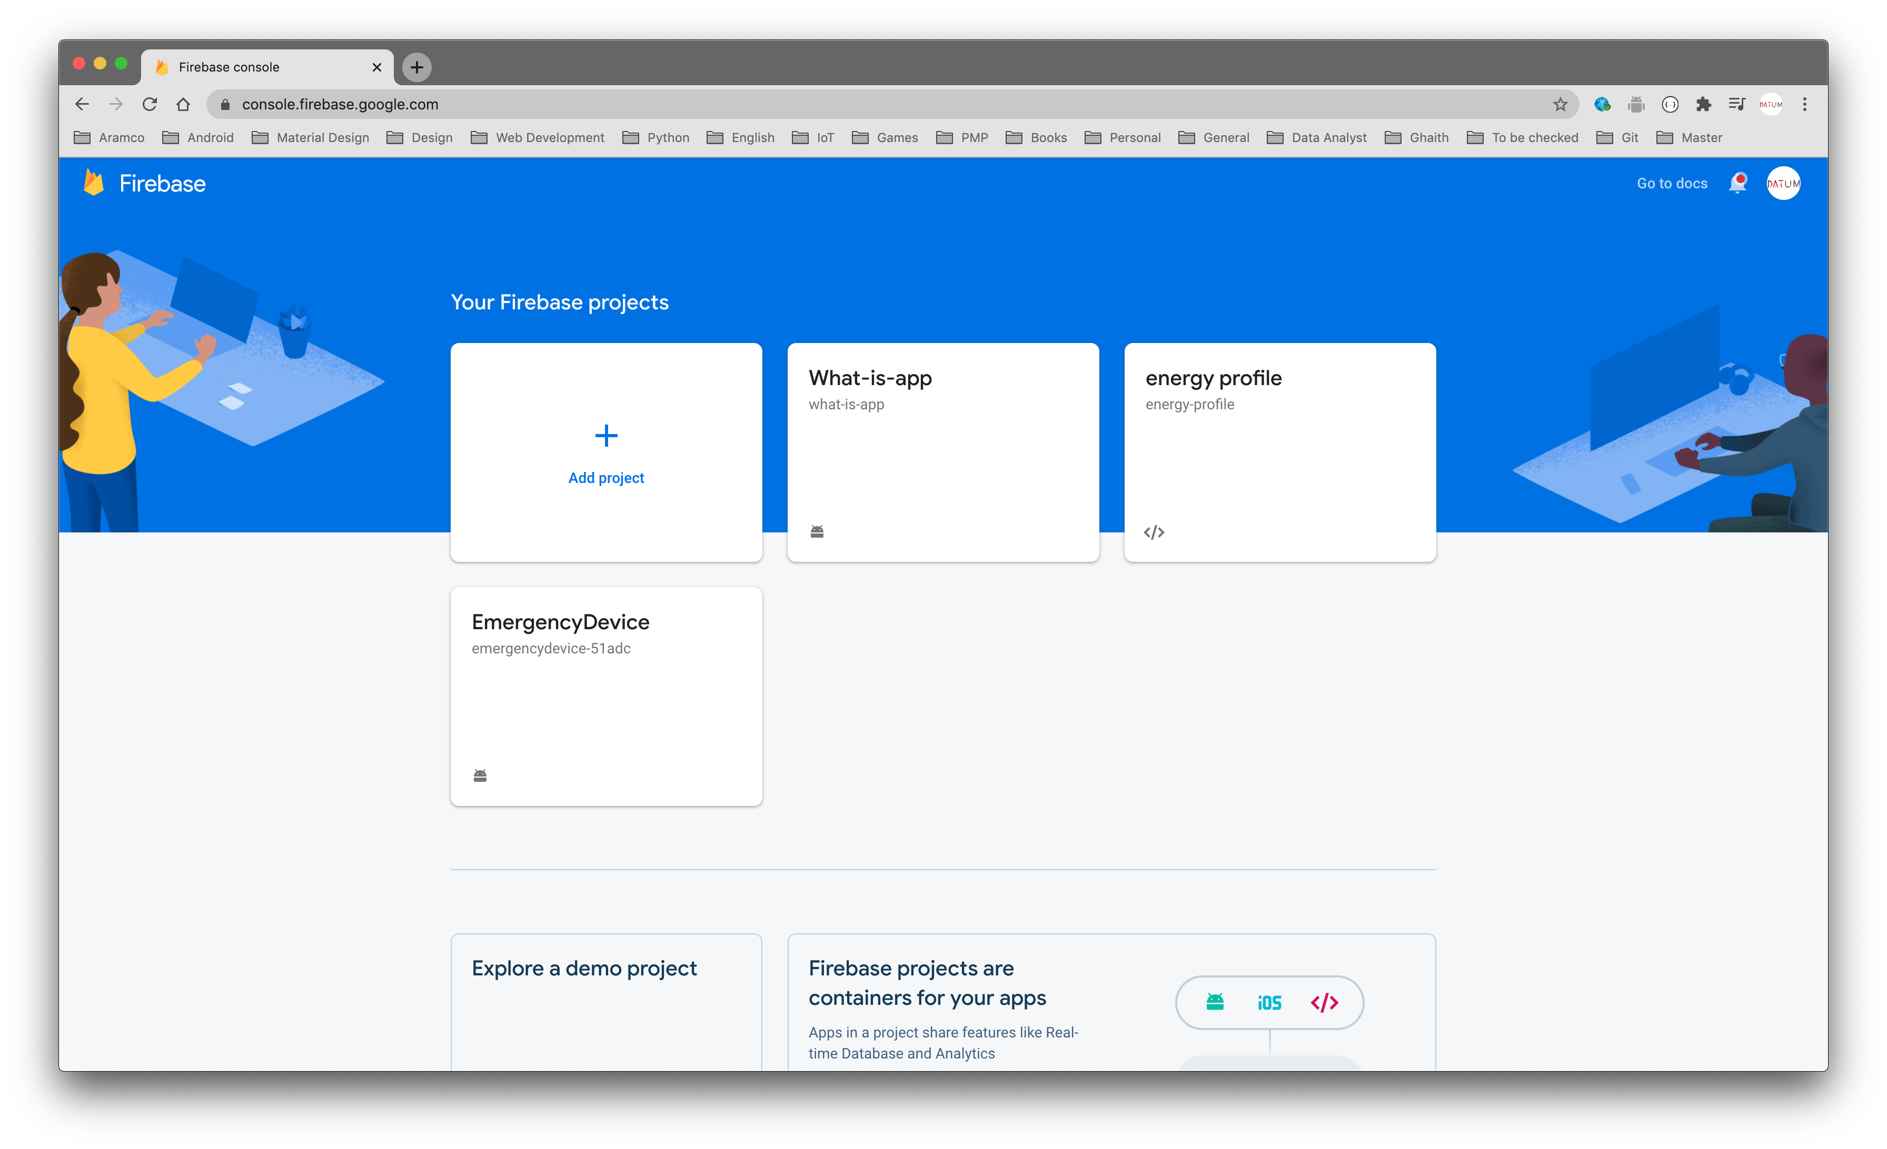

Slide 100
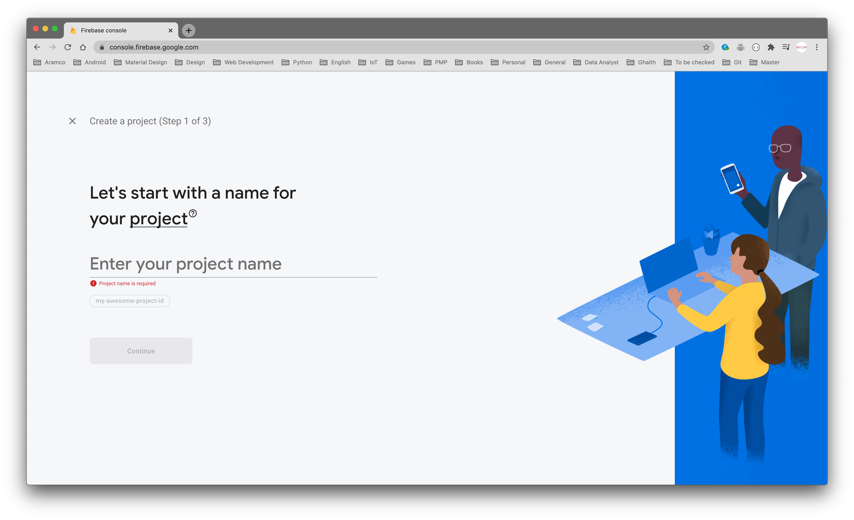

Slide 101
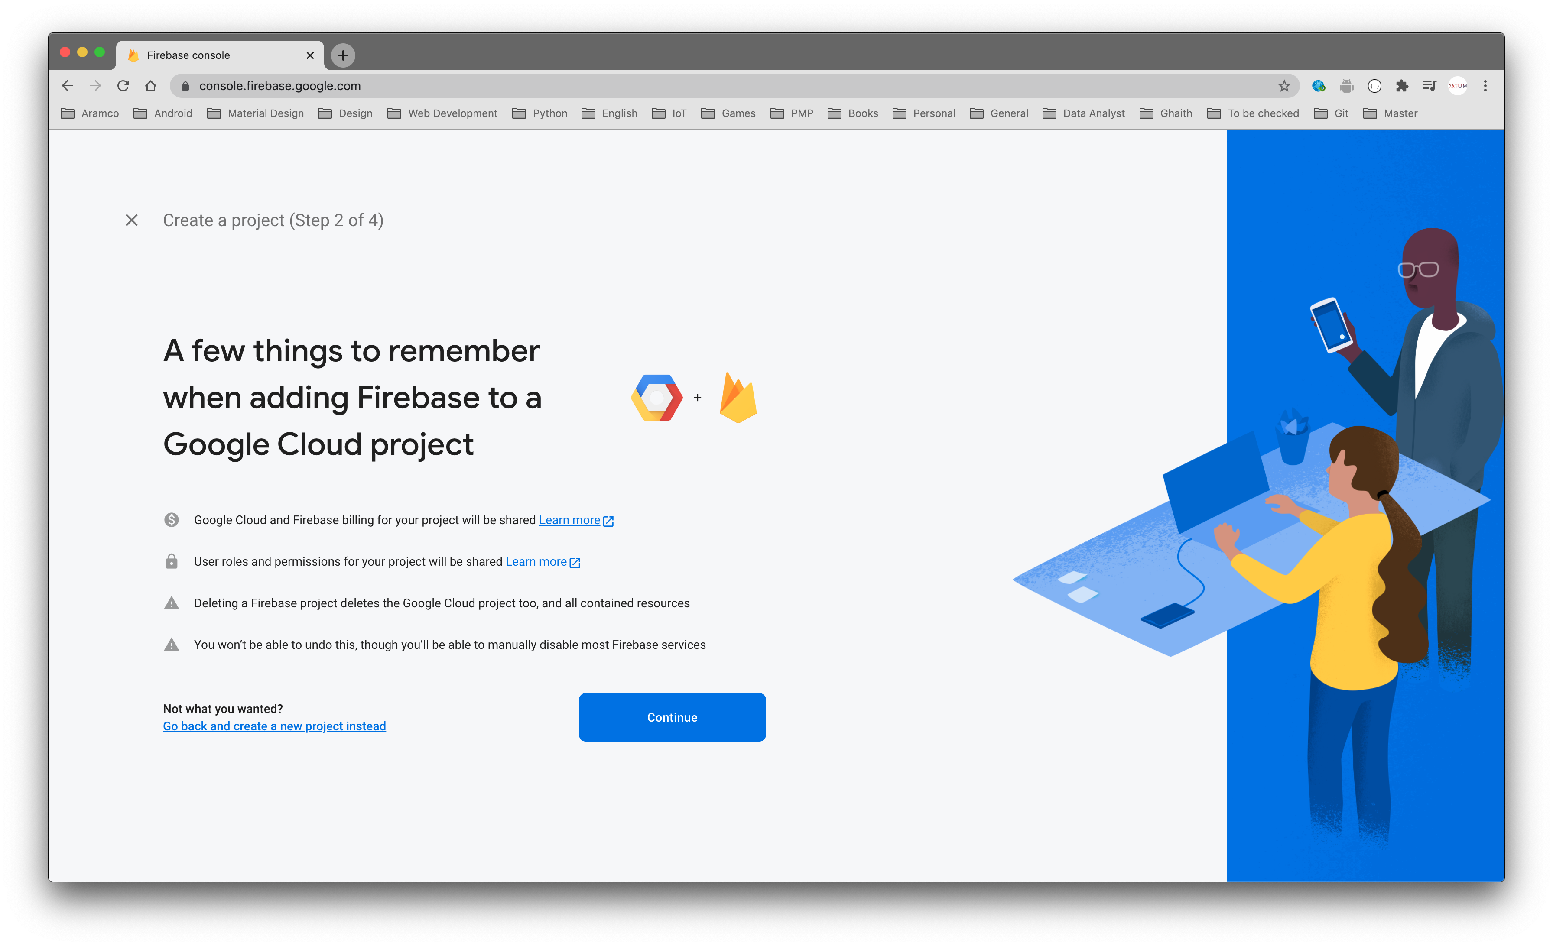

Slide 102
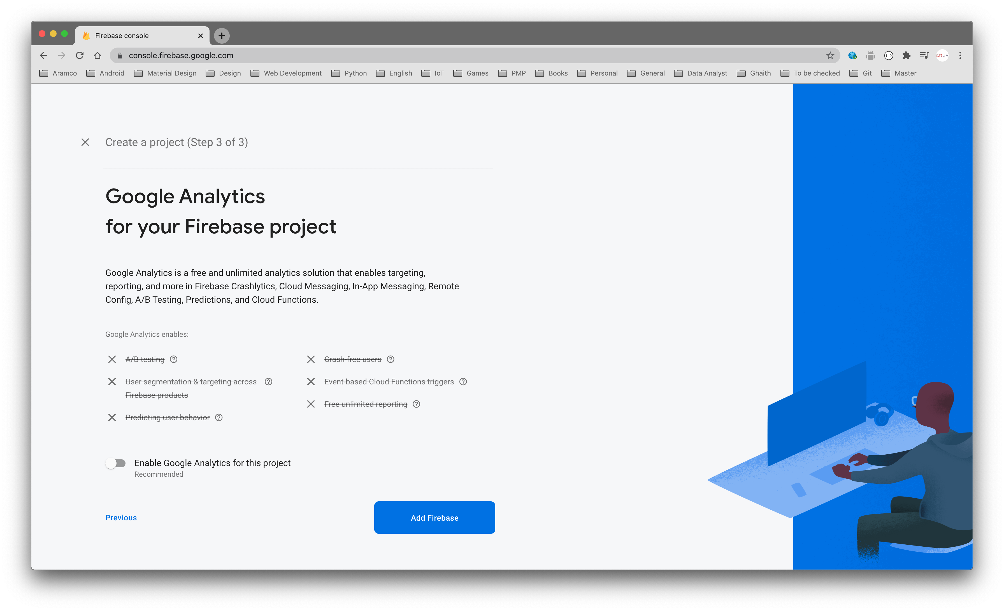

Slide 103
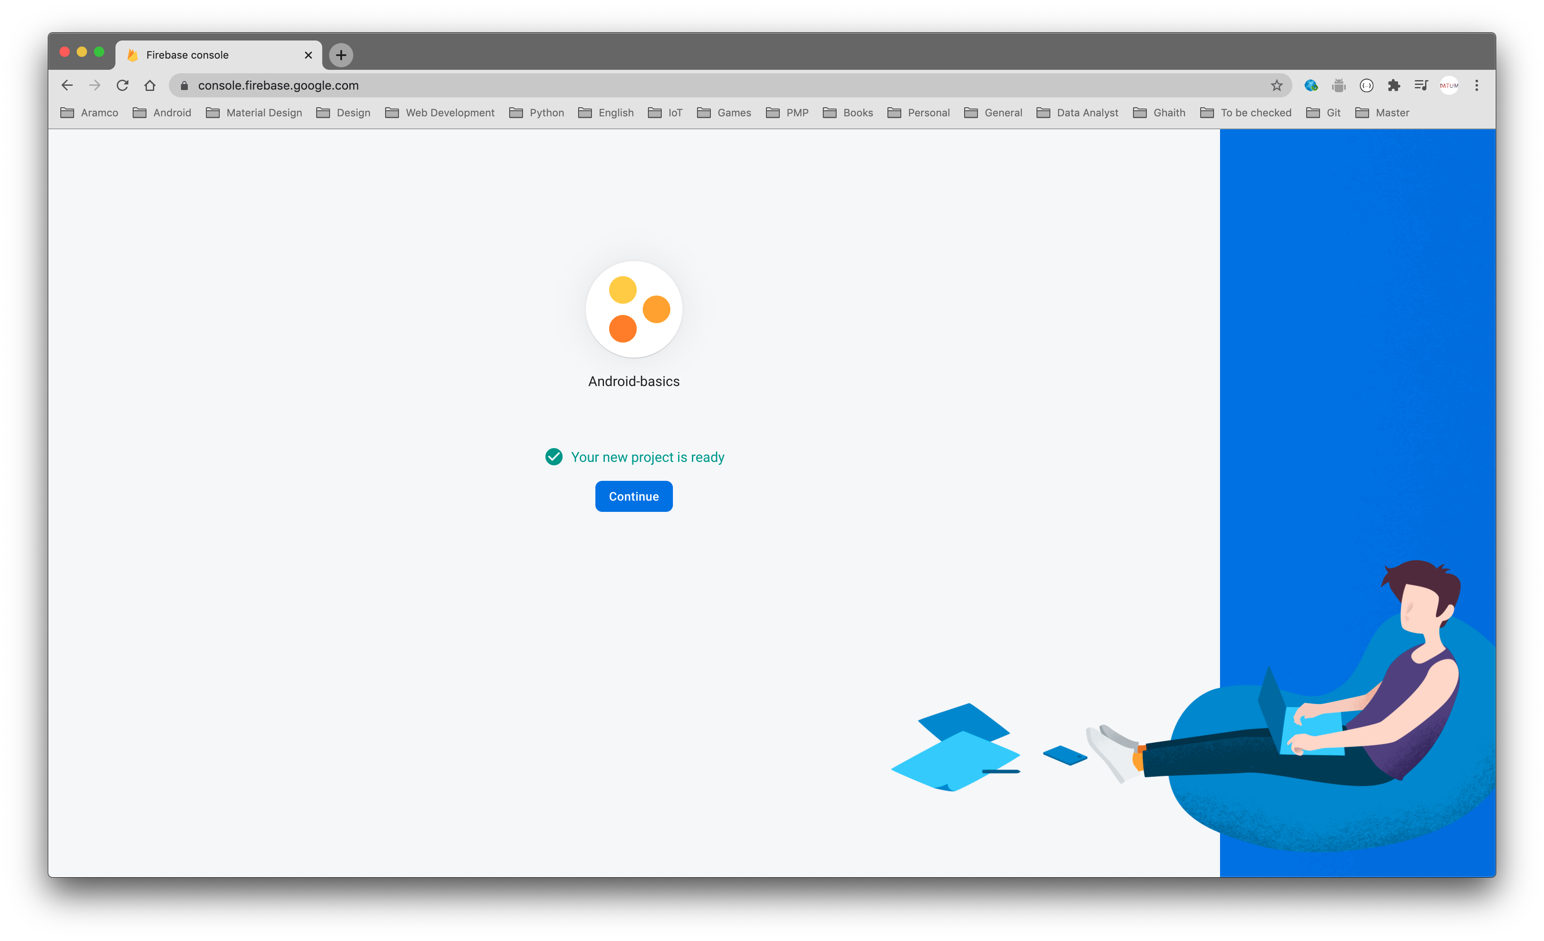

Slide 104
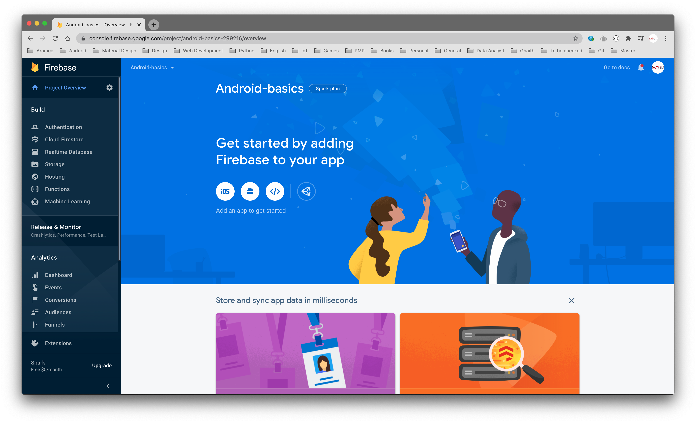

Slide 105
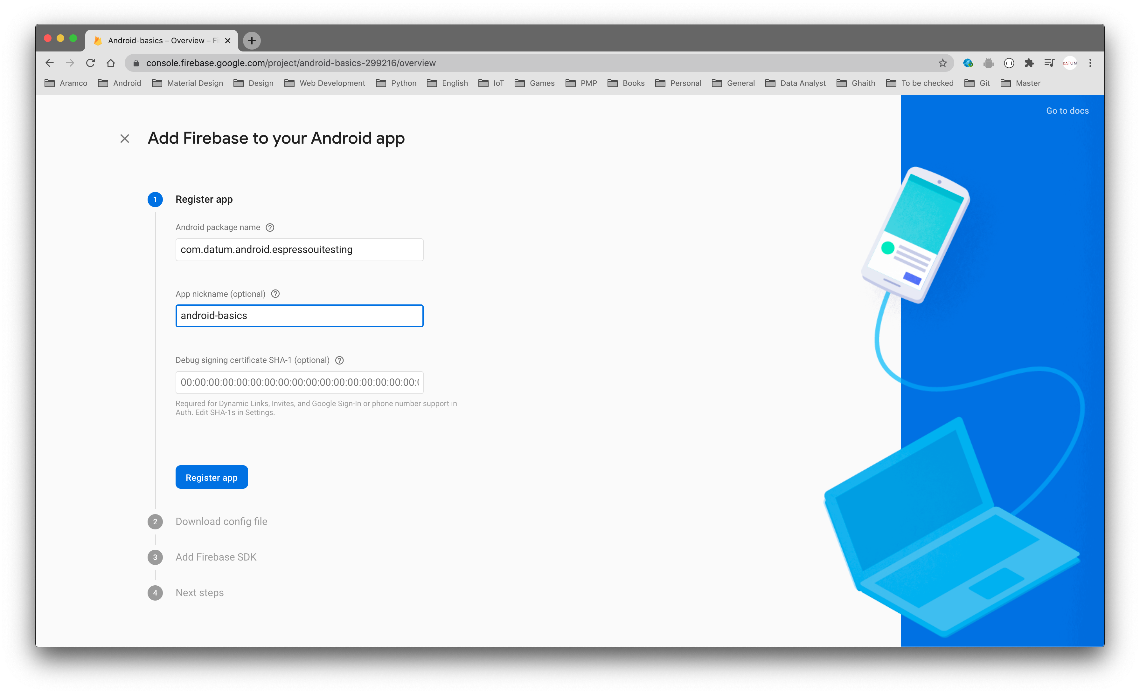

Slide 106
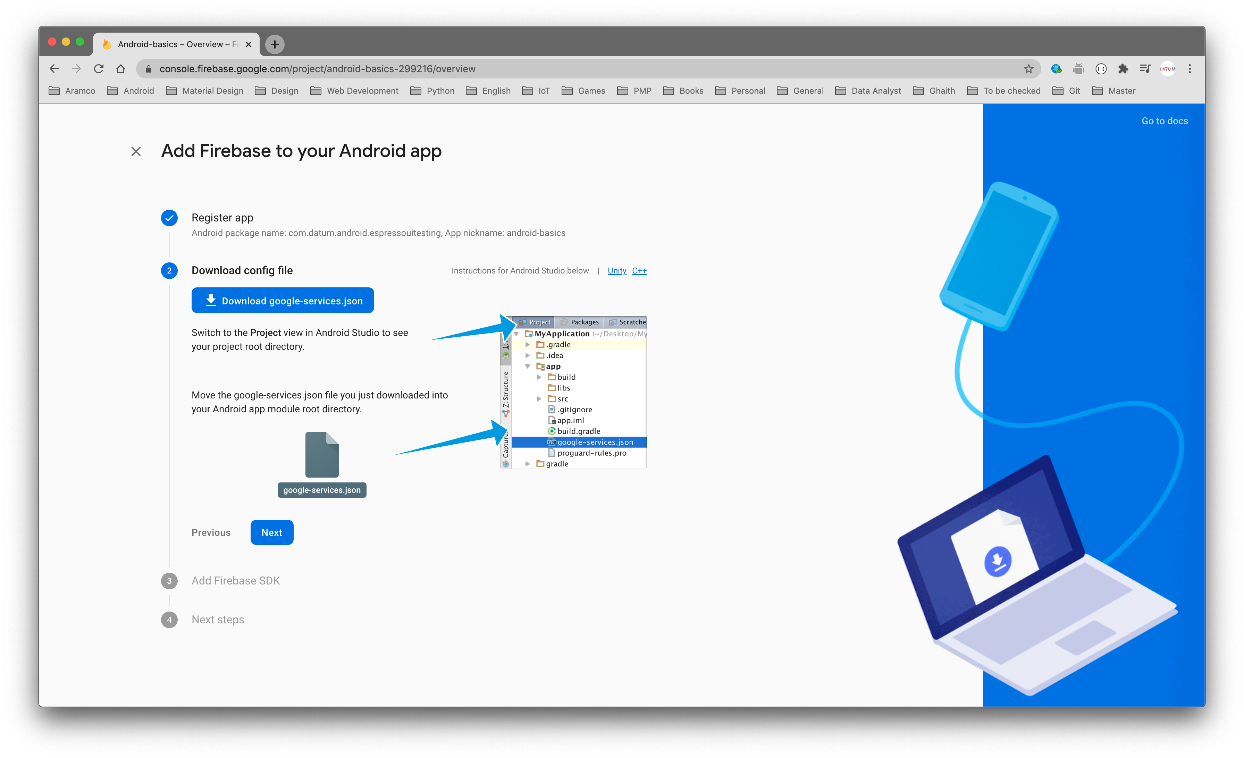

Slide 107
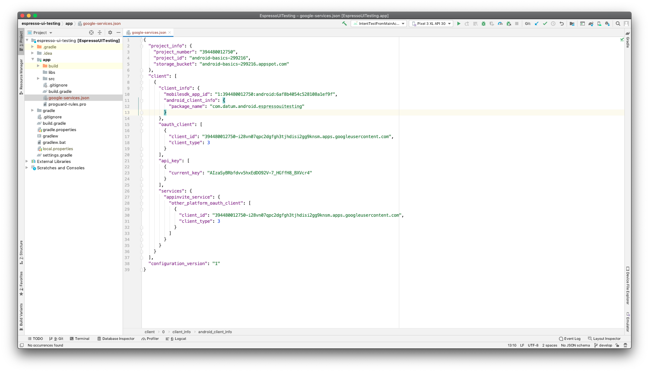

Slide 108
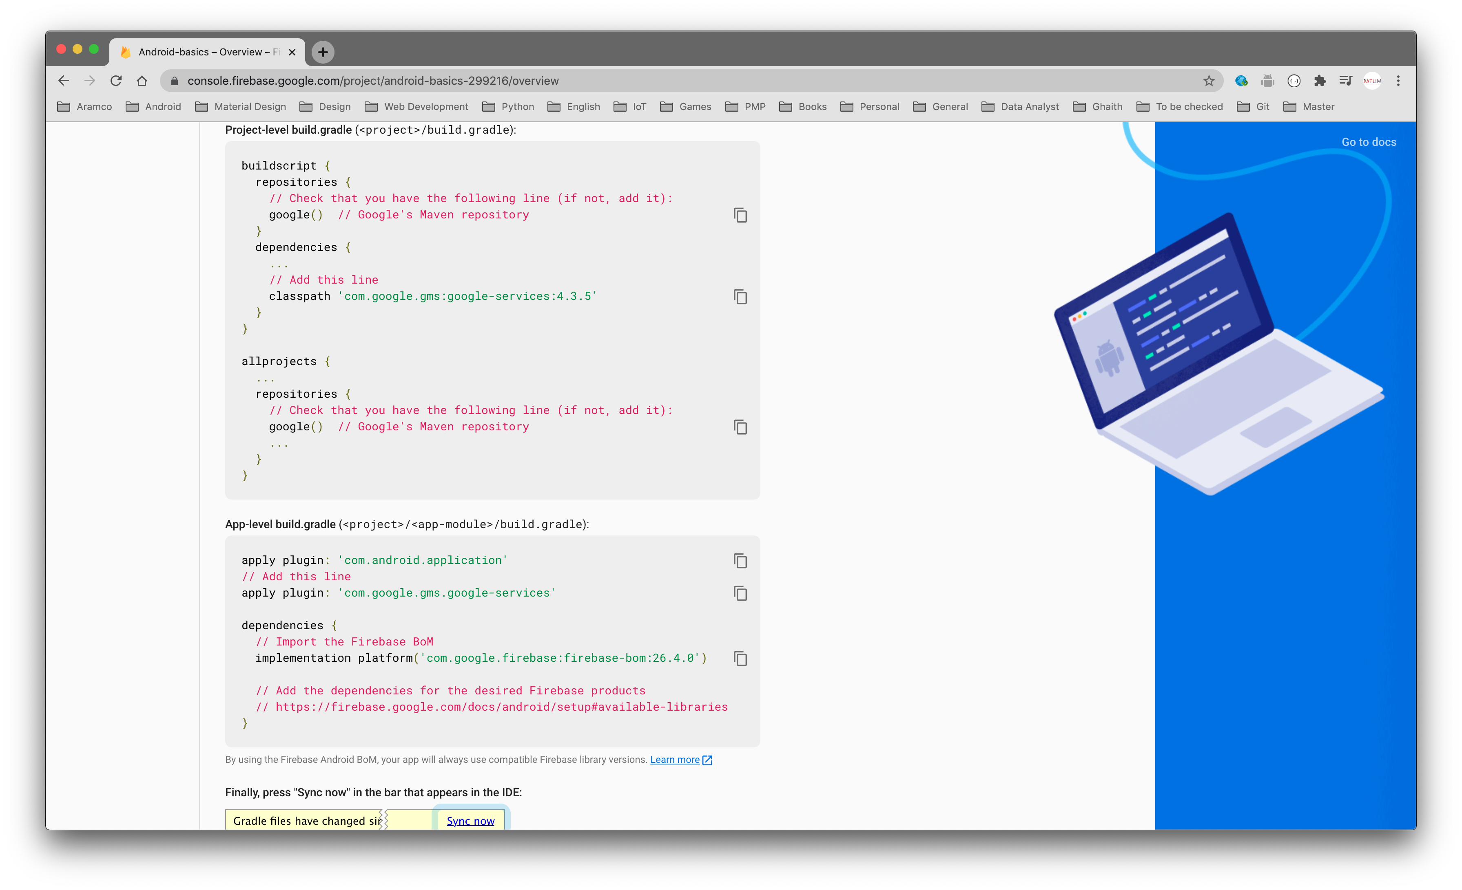

Slide 109
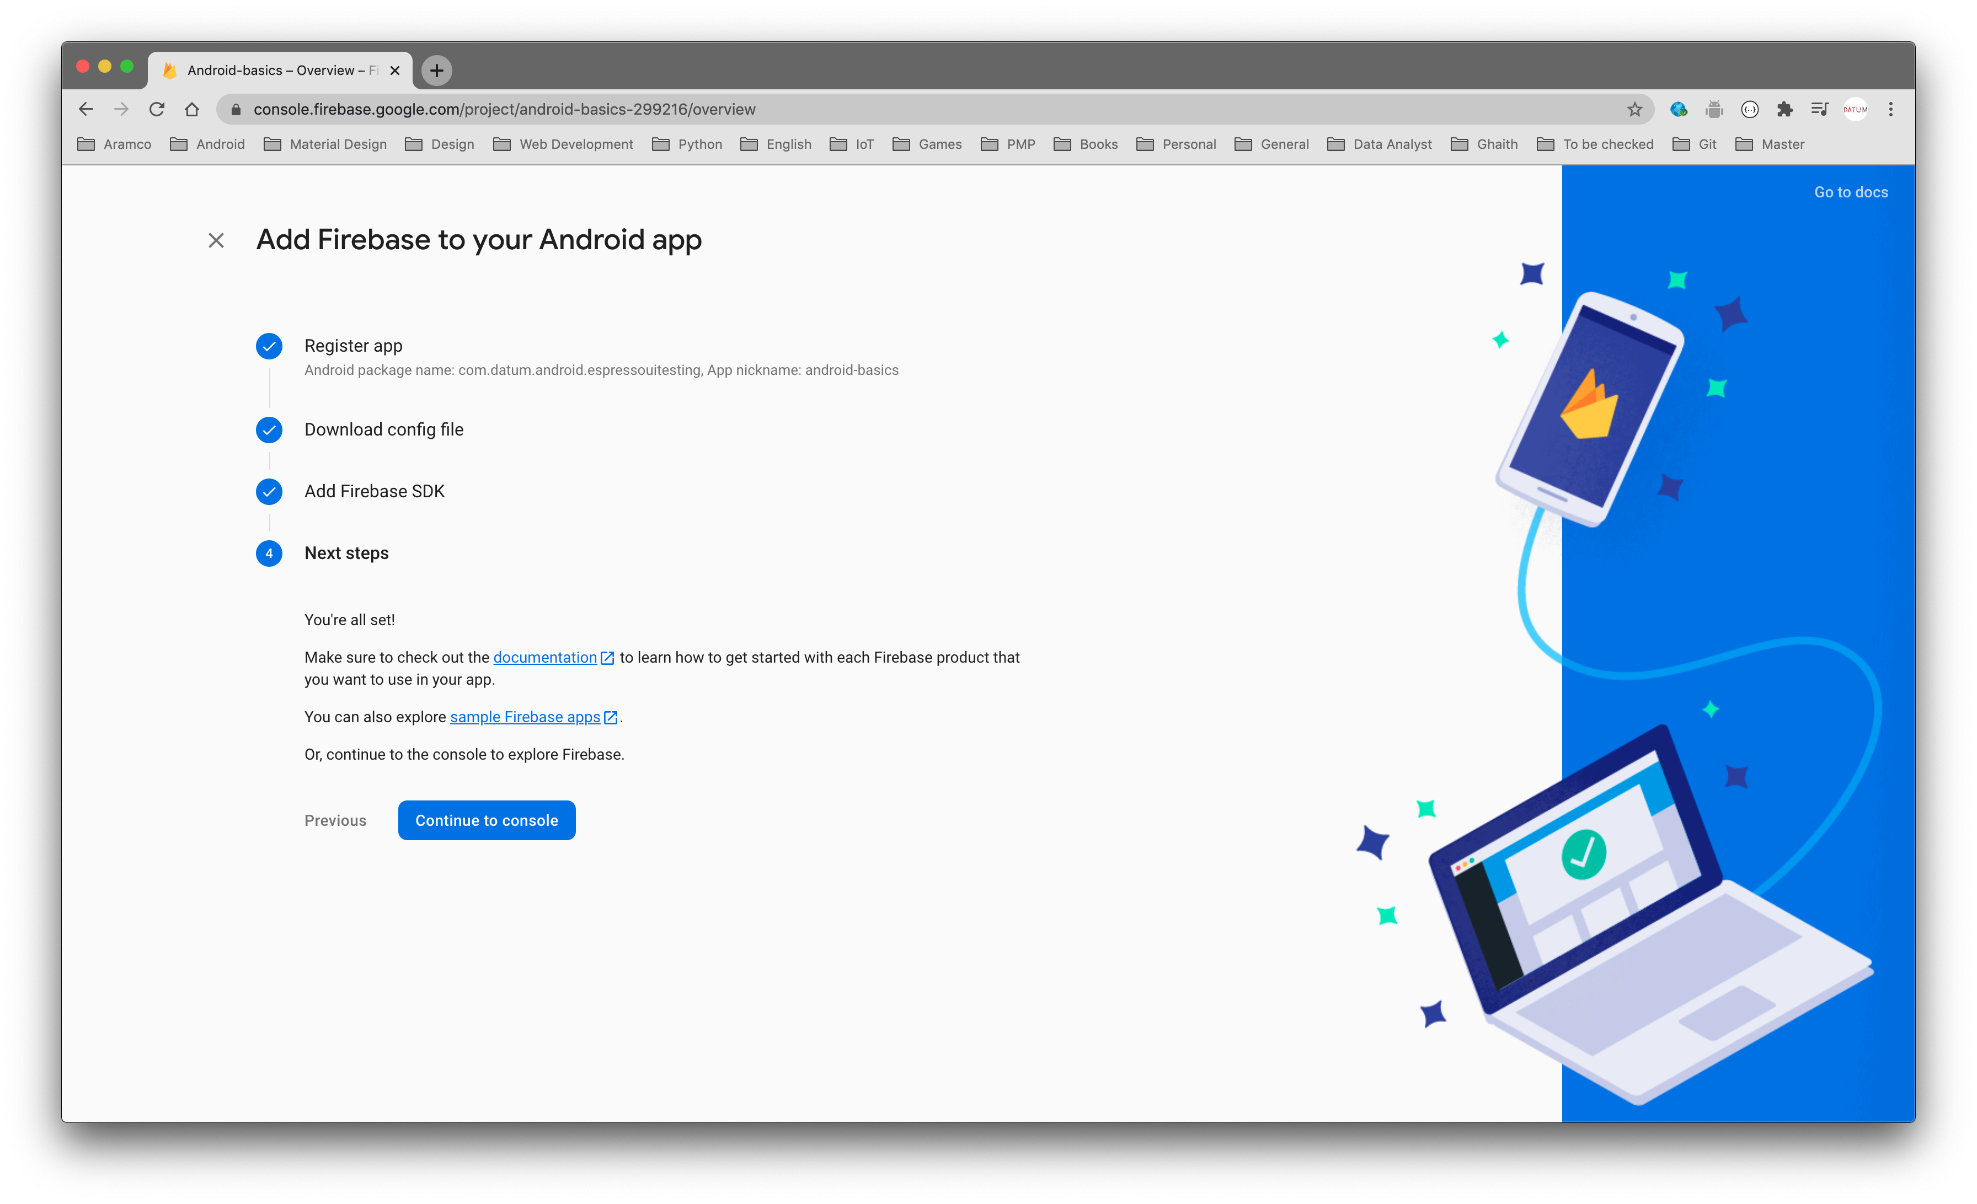

Slide 110
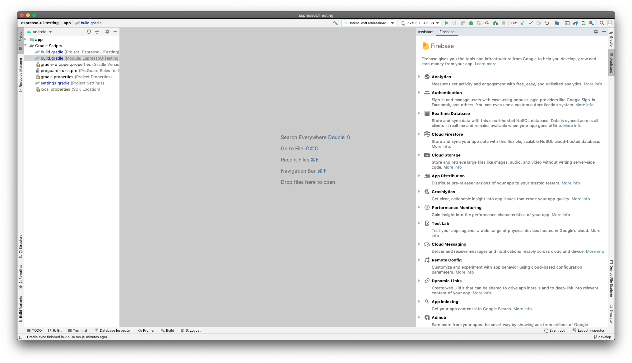

Slide 111
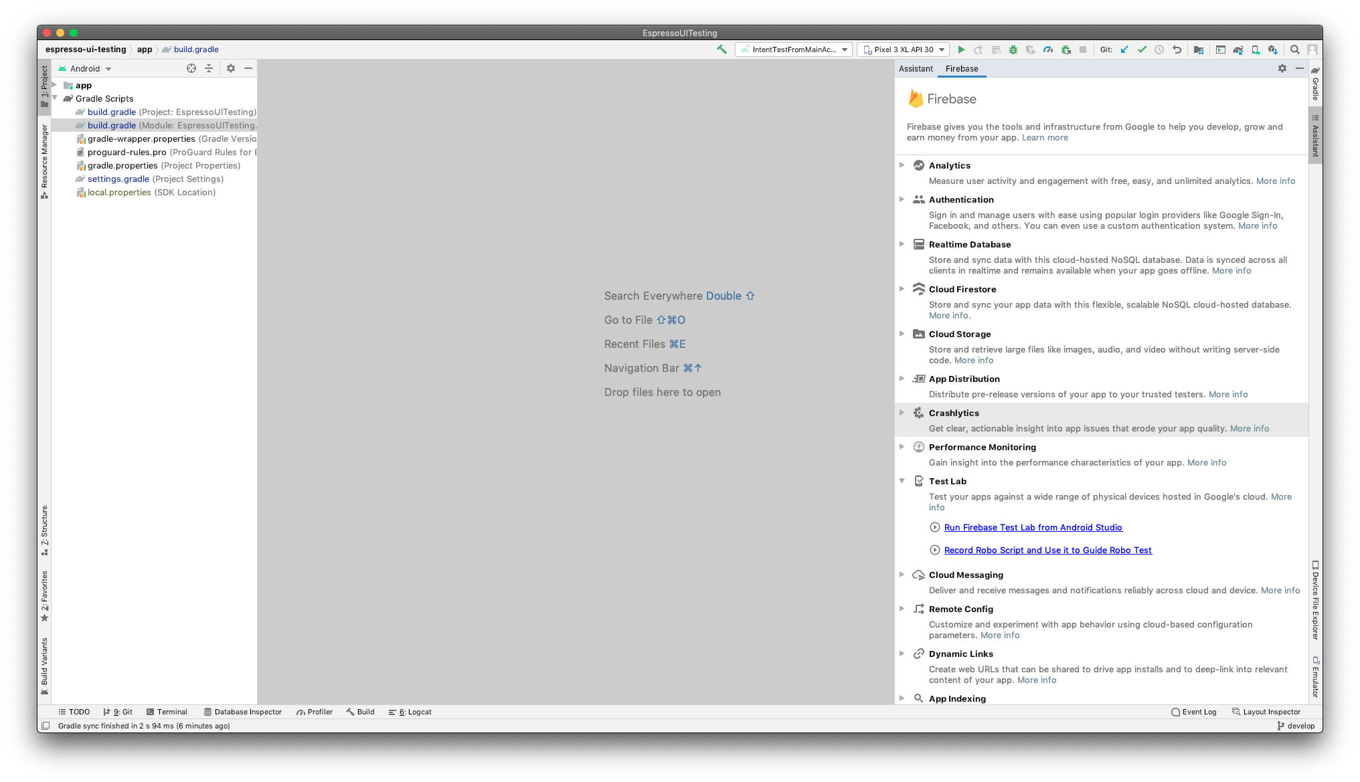

Slide 112
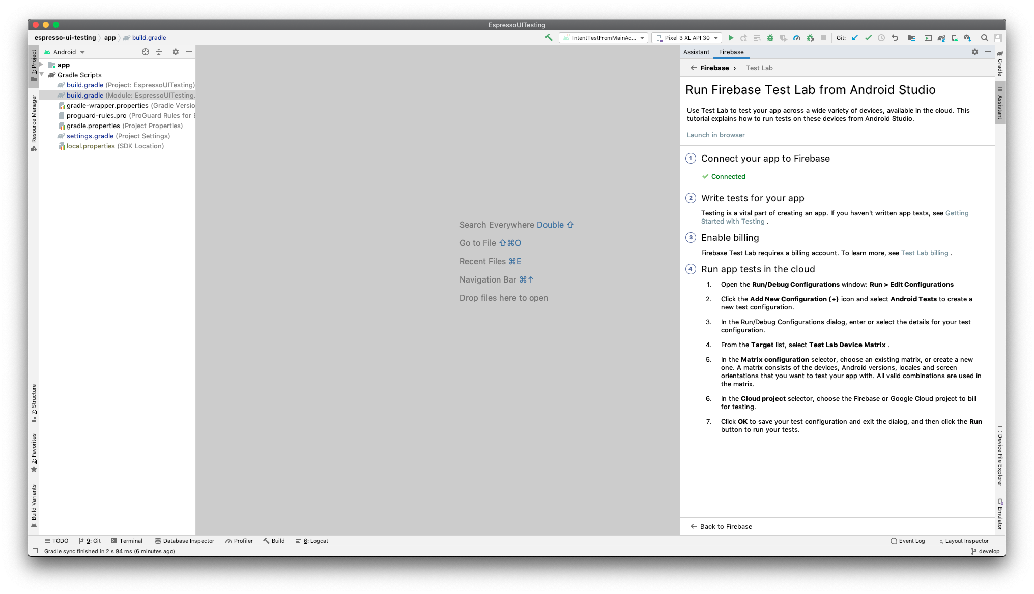

Slide 113
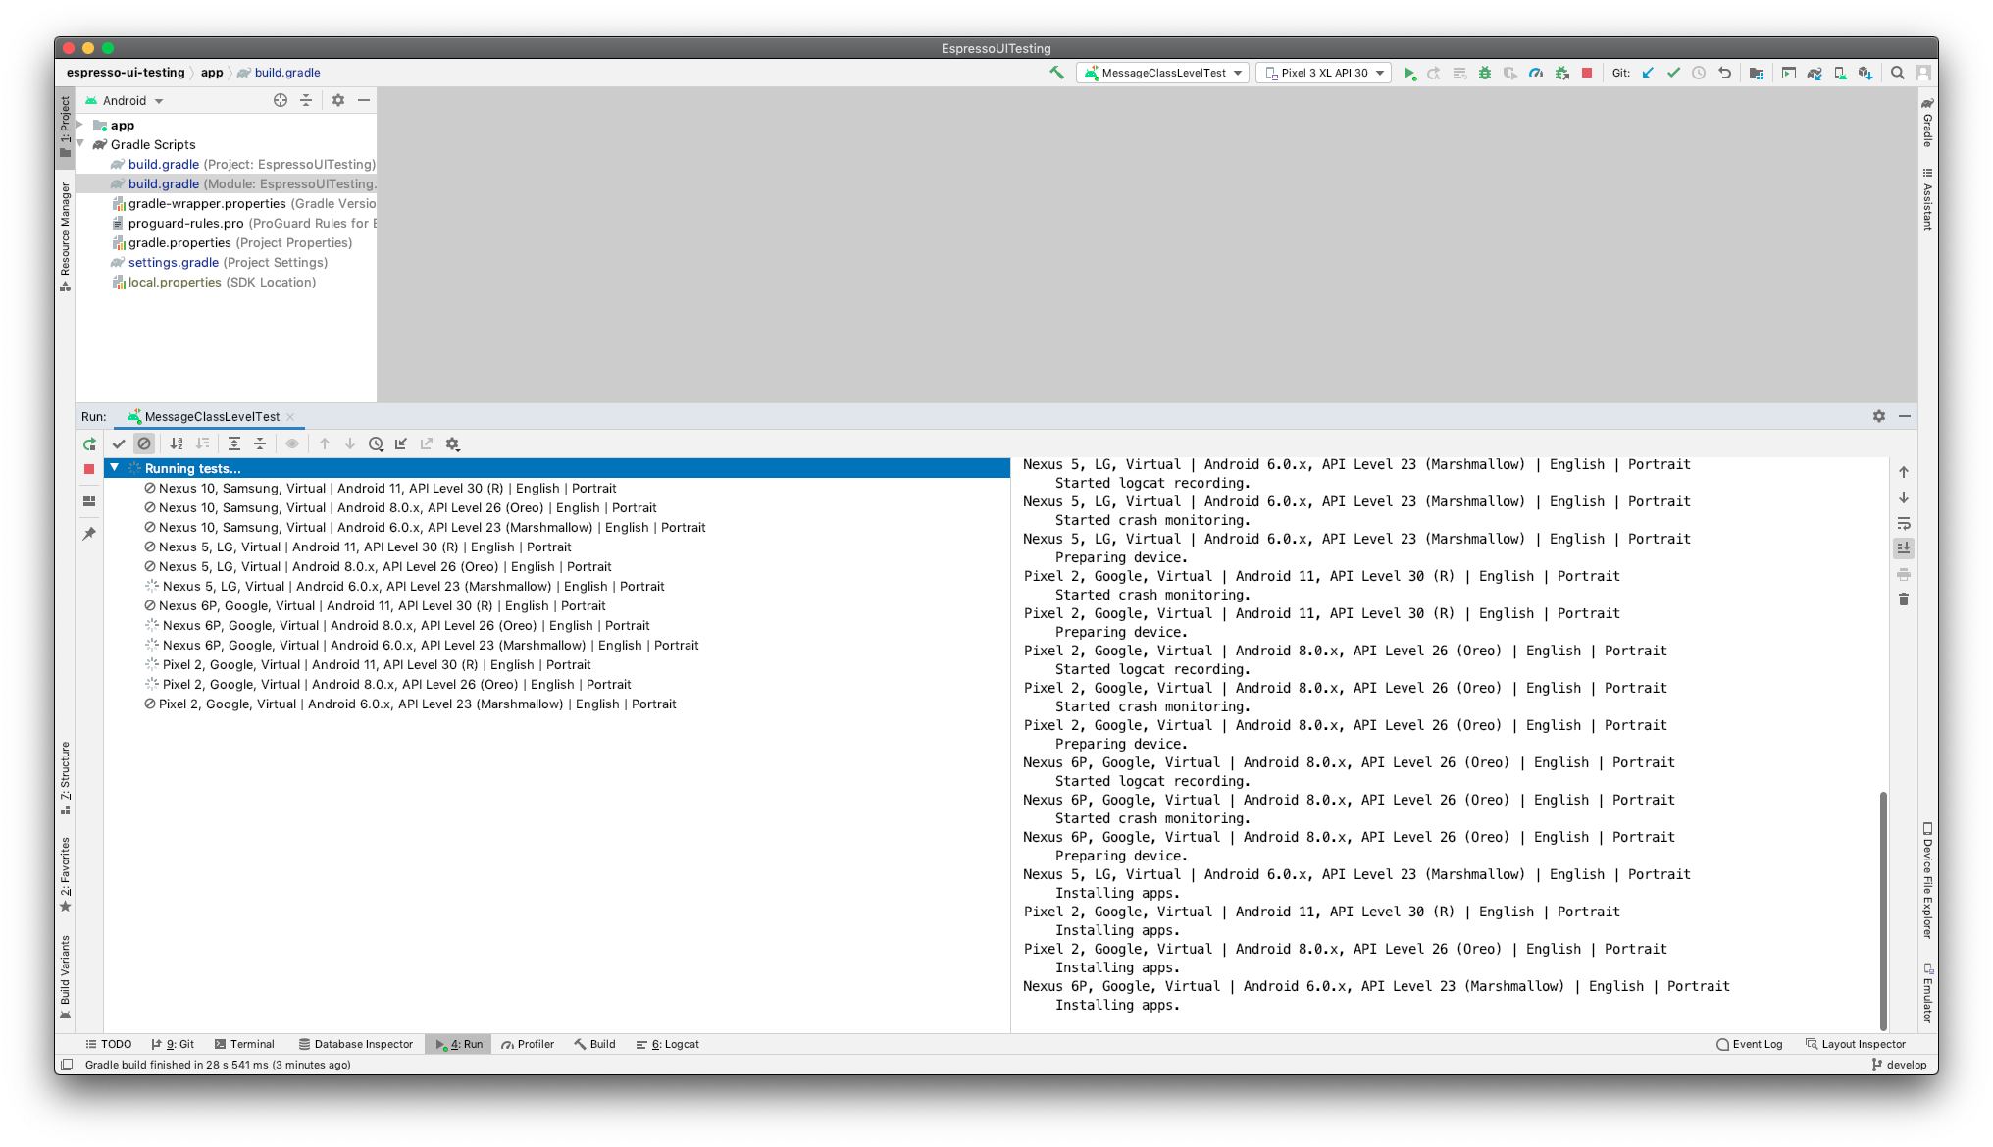

Slide 114
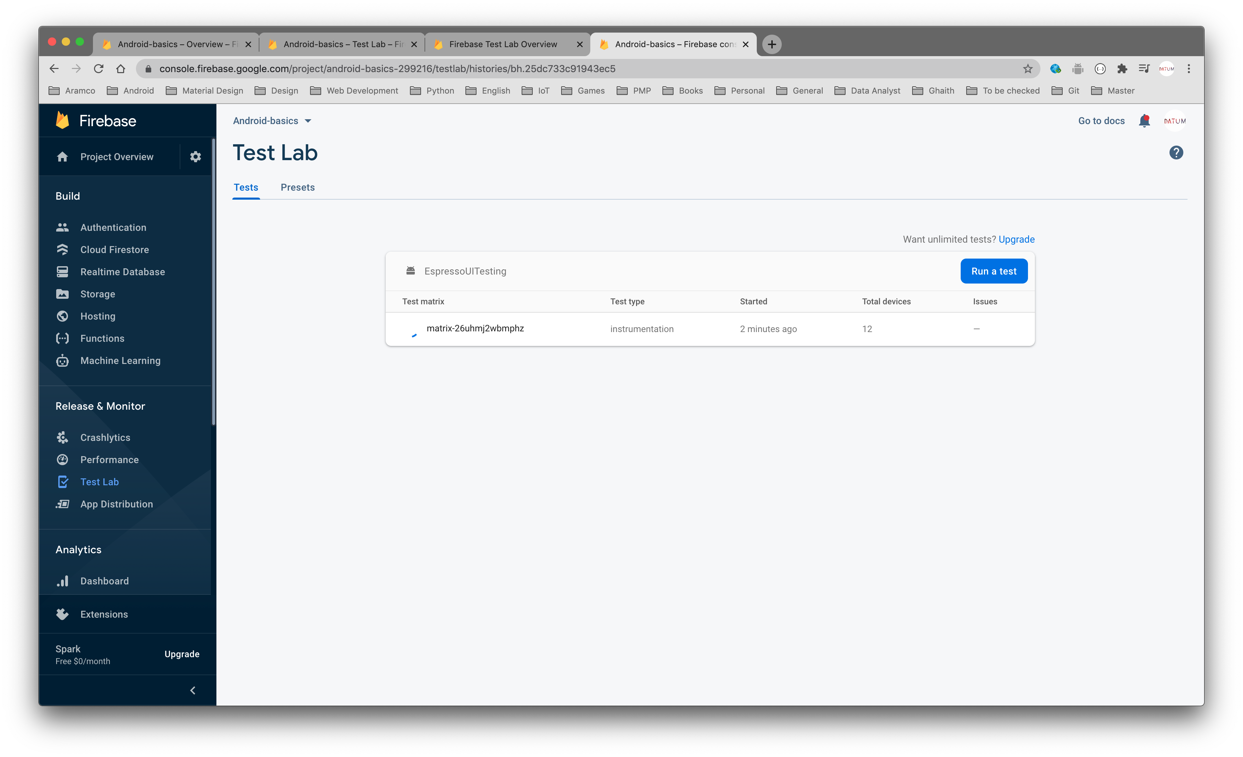

Slide 115
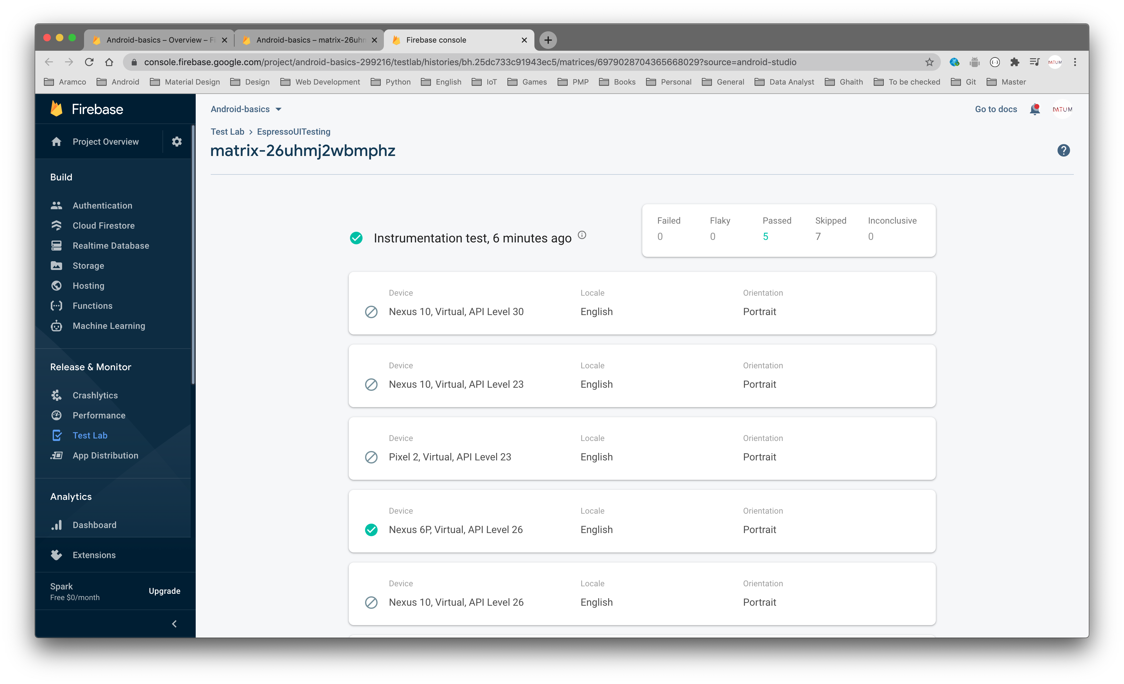

Slide 116
https://github.com/android/testing-samples

Slide 117
Thanks

